Slide 1
Home Automation Using Raspberry pi and Image Processing
Class :B.Tech Computer
Academic Year: 2020-2021
Team Members
1.Abhishek Suresh Bhosale
2.Atharv Sanjay Burade
3.Ashitosh Shankar Kadam
4.Vaibhav Milind More
Project Guide
Prof. (Dr.)Yogesh Deshpande

Slide 2
01
03
05
Introduction
Image Processing
02
04
System Design
Hardware Requirements
06
Software Requirements
References

Slide 3
01
Introduction

Slide 4
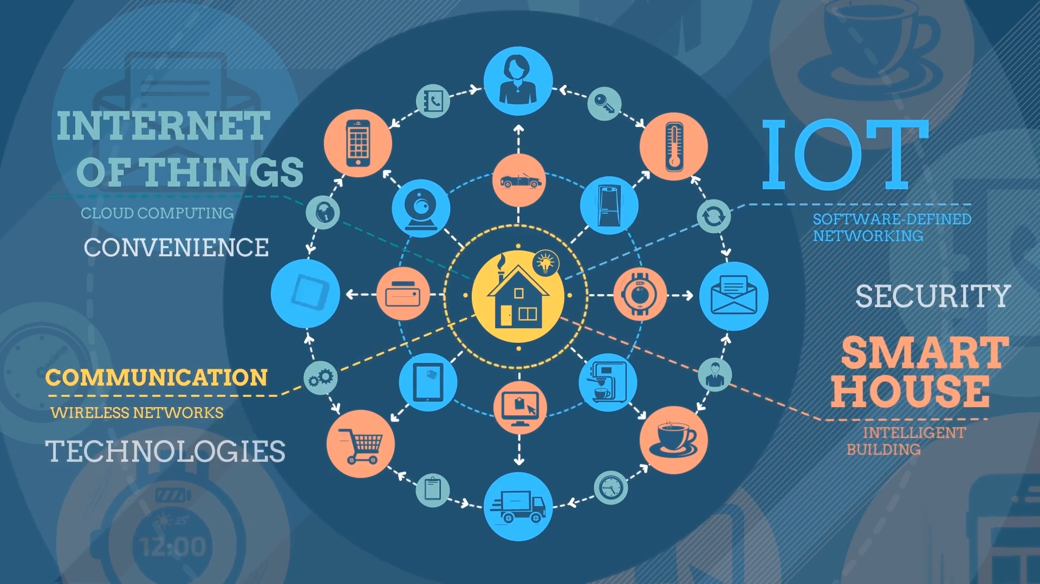
1.1 INTERNET OF THINGS(IOT)
1.1.1 What is IOT ?
1.1.2 Advantages
1.1.3 Scope

Slide 5
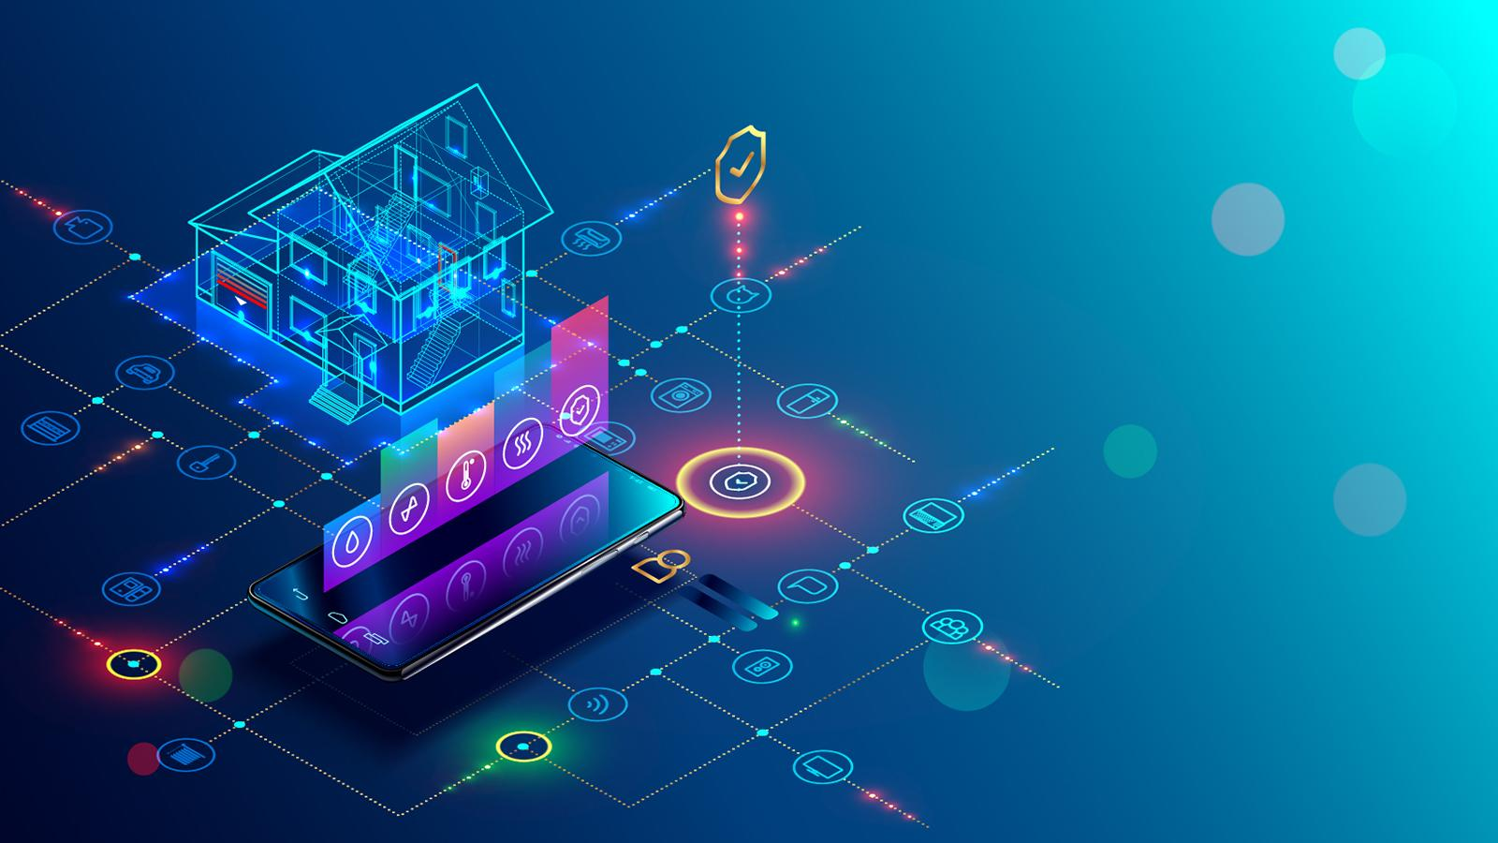
1.2 HOME AUTOMATION
1.2.1 What Is Home Automation System ??
1.2.2 Scope
1.2.3 Objective

Slide 6
02
System Design

Slide 7
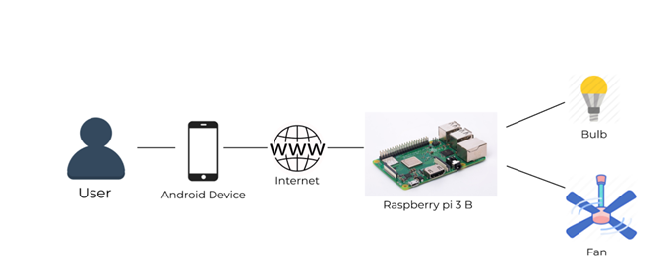
2.1 System Architecture

Slide 8
03
Hardware Requirements

Slide 9
3.1 Raspberry pi 3 B
3.2 Raspberry Pi camera rev 1.3
3.3 Transformer
3.4 Relay
3.5 PIR Motion Sensor
3.6 Temperature Sensor(LM35)
3.7 LED

Slide 10
04
Software Requirements

Slide 11
4.1 Raspbian Operating System
4.2 WIN32 Disk Imager
4.3 ThingSpeak
4.3.1 Creating Channels
4.3.2 API Keys
4.3.3 API Request
4.3.4 Private View
4.4 MIT APP Inventor

Slide 12
05
Image Processing

Slide 13
5.1 Haar Cascade
5.2 Haar Cascade frontal face

Slide 14
08
References
1. https://www.researchgate.net/publication/327423472_IoT_Based_Home_Automation_Using_Raspberry_Pi
2. "https://www.jncet.org/Manuscripts/Volume-6/Issue-12/Vol-6-issue-12-M-01.pdf
3. Adafruit, [Online]. Available: https://learn.adafruit.com.
4. P. Damacharla, A. Y. Javaid, J. J. Gallimore and V. K. Devabhaktuni, ”Common Metrics to Benchmark Human-Machine Teams (HMT): A Review,” in IEEE Access, vol. 6, pp. 38637-38655, 2018.
5. J. Voas, B. Agresti and P. A. Laplante, ”A Closer Look at IoT ’s Things,” in IT Professional, vol. 20, no. 3, pp. 11-14, May./Jun. 2018.
6. Q. F. Hassan, ”Internet of Things Applications for Agriculture,” in Internet of Things A to Z: Technologies and Applications , IEEE, 2018
7. O. Benderius, C. Berger and V. Malmsten Lundgren, ”The Best Rated HumanMachine Interface Design for Autonomous Vehicles in the 2016 Grand Cooperative Driving Challenge,” in IEEE Transactions on Intelligent Transportation Systems, vol. 19, no. 4, pp. 1302-1307, April 2018
8. S. Ziegler, S. Nikoletsea, S. Krco, J. Rolim and J. Fernandes, ”Internet of Things and crowd sourcing - a paradigm change for the research on the Internet of Things,” 2015 IEEE 2nd World Forum on Internet of Things (WF-IoT), Milan, 2015, pp. 395-399.

Slide 15
Thank you !

